Slide 1


Artificial Intelligence in the Wild
Decision Trees
Dr Oisín Cawley

Slide 2
Decision Trees
Used to solve classification problems:
The state of the world is a set of attributes (or features) e.g. what can I see, how far away is it, how much battery do I have left …
Given any state, there is one appropriate action to take
Decision trees are:
Fast to execute in code
Easy to implement in a scripting language
Easy to understand
Easy to modify
Can be used for machine learning

Slide 3
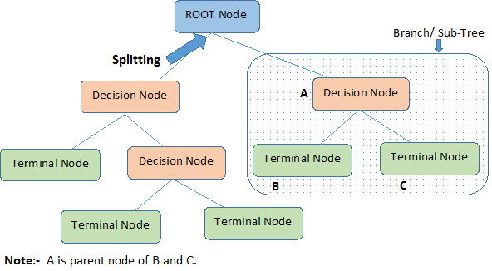
Decision Trees
They are quite often Binary Trees (BT)
Nodes represent attribute tests (a decision)
One child for each possible outcome of the test
Leaf nodes/Terminal nodes represent classifications (actions)
Can have the same classification for several leaves
In a BT each Decision node has two child nodes. Each node represents either:
an Action (Leaf/Terminal)
another Decision node

Slide 4
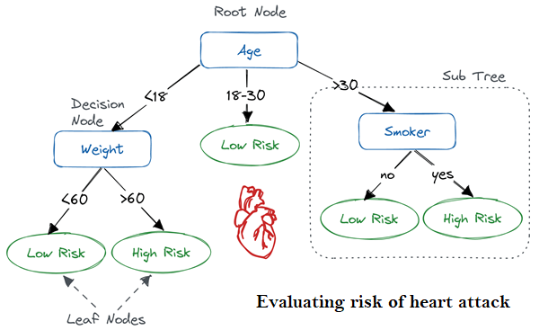
Decision Trees
They are flowchart like.
Mimics human-level thinking.
Makes them easy to understand and interpret.
The Tree partitions on the basis of the attribute value.

Slide 5
Decision Trees
Actions
An action can be anything
An identification (categorisation)
A command to switch something on
A command to turn left/right/reverse/break
A call to a game engine API
A command to raise a cyber-attack alarm
A decision to do nothing
…
Action nodes are Leaf nodes
Multiple Leaf nodes can have the same action

Slide 6
Processing a Decision Tree
To execute a decision tree:
We start at the root node
Evaluate the decision in that node
Chose which node to move to based on the outcome of the decision
Move to child node and repeat
We stop when we reach an action node, where we perform the associated action
Note: A DT is termed a white box machine learning algorithm because it’s decision-making logic is clearly shared. This is not the case in black box algorithms such as neural networks.

Slide 7
Building a Decision Tree
Decision trees can be constructed by hand
But how do we decide which decisions should be made, and in which order?
Decision trees are ideally learned:
Why? We don’t know how to decide on an action, so let the computer do the work
Provide examples (training data): many sets of attribute values and resulting actions/decisions
An algorithm then constructs a tree from the examples e.g. ID3

Slide 8
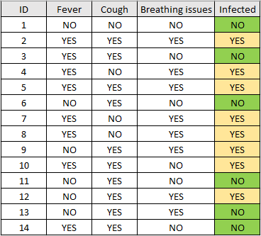
Building a Decision Tree
Attributes
Outcome/Action/
Decision/Category
For example

Slide 9
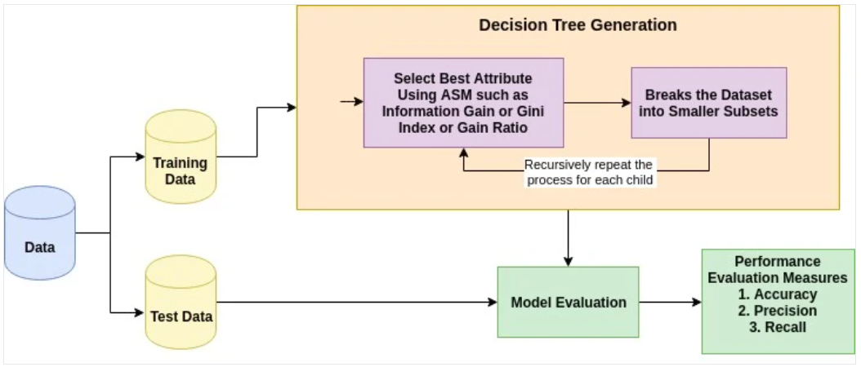
Building a Decision Tree
Select the best attribute using an Attribute Selection Method (ASM) to split the training data.
Make that attribute a decision node (root node) which breaks the dataset into smaller subsets.
Continue tree building by repeating this process recursively for each child node.

Slide 10
Attribute Selection Method
When presented with a set of training data, we use an Attribute Selection Method to select the attribute that best partitions the data into distinct classes.
Also commonly known as splitting rules.
The method is used to rank all the attributes in the data.
The attribute with the highest ranking is selected as the first decision node.
Note: If the method does not split the data equally, the depth of the decision tree increases and hence the time consumed for parsing the tree also increases. So the selection of the correct splitting attribute is very essential.
So, how do we rank them?

Slide 11
ID3 - Iterative Dichotomiser 3
ID3 is a basic learning algorithm created by Ross Quinlan in 1986 “Induction of Decision Trees”
C4.5 and now C5.0 are updated and extended versions (look them up if you like)
A classification solving algorithm
If we have categorical data, for example: hot, mild, and cold.
If we have attribute-value pairs of data, for example: an attribute ‘temperature’ may have some discrete values ‘hot’, ‘mild’, and ‘cold’.
If the objective value has discrete output values, for example ‘yes’, or ‘no’
Given some sample data, ID3 Learns the decision tree by constructing it top-down.
Starting with the question “Which attribute should be tested at the root of the tree?”
Notes:
ID3: https://link.springer.com/content/pdf/10.1007/BF00116251.pdf
https://medium.com/machine-learning-guy/an-introduction-to-decision-tree-learning-id3-algorithm-54c74eb2ad55

Slide 12
ID3 - Iterative Dichotomiser 3
At each step in the algorithm, decide which attribute best classifies (divides up) the training data at that point.
We end up with a tree structure representing a hypothesis which works best for that training data.
But what is a good quantitative measure of the worth of an attribute?
“Knowledge once gained casts a faint light beyond its own immediate boundaries.”
John Tyndall 1870
“On the Methods and Tendencies of Physical Investigation”
Notes:
https://en.wikipedia.org/wiki/John_Tyndall

Slide 13
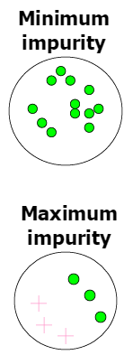
ID3
Information Gain
Can be thought of as the level of impurity in a group of examples.
Measures how well a given attribute separates the training examples according to their target classification.
At each step ID3 picks the attribute with the highest gain.
Information gain is therefore a Heuristic which we can estimate.
But to understand information gain, we must understand entropy.

Slide 14
ID3
Entropy
A measure of disorder in a system.
Entropy for a set of examples, S, can be given as follows (for a binary classification task):
Entropy(S) = -(p+)log₂(p+) – (p-)log₂(p-)
Where (p+) is the proportion of positive examples (or one category) in S and (p-) is the proportion of negatives (or the other category).
If all examples belong to the same category, entropy is 0. If all examples are equally mixed, entropy is 1.
In general, entropy represents a level of uncertainty.

Slide 15
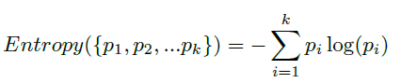
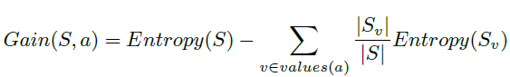
ID3
Entropy in the general case:
We can now understand the notion of information gain:
“the expected reduction in entropy caused by partitioning on a given attribute”.
Gain of an attribute a relative to a collection of examples S is defined as:
where S_{v} is the subset of S where attribute a has value v, |S_{v}| is the number of rows in S_{v} , and the entropy of partitioning the data is calculated by weighting the entropy of each partition by its size relative to the original set.

Slide 16
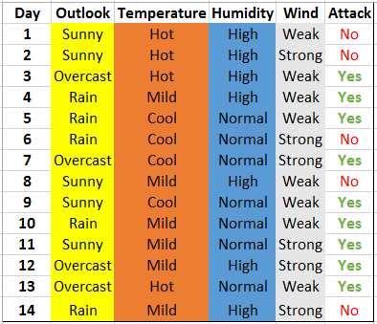
ID3 - Example
Naval Fleet data:

Slide 17
ID3 - Example
Example: Do we attack or not today?
Find entropy of the complete/current space
Compute Information Gain for each attribute
Select attribute with highest Gain for next node in tree
Repeat steps 1-3
Check out this online calculator:
https://planetcalc.com/8421/?license=1

Slide 18
ID3 - Example
Consideration:
What about continuous attributes and/or output values?
Divide values into small number of discrete categories
Then run ID3
Did you know…
How to compute log₂(x)?
In general: log_{n}(x) = log(x) / log(n)
log₂(x) = log(x) / log(2)

Slide 19
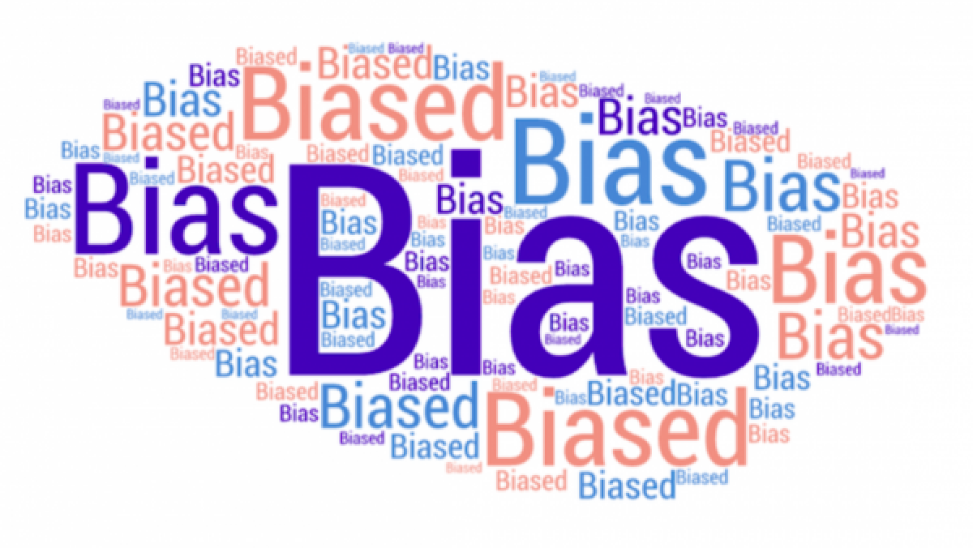
Building Decision Trees
Where do examples come from and whose behaviour would we wish to learn?
We could learn something bad!
The number of examples needed depends on the concept difficulty (number of tests needed to determine the action).
More examples is always better.
Training set vs. Testing set.
Train on most (75%) of the examples
Use the rest to validate the learned decision trees by estimating how well the tree does on examples it hasn’t seen
Just like with K-NN, this is the typical process of machine learning in general.

